Slide 1
IBM Hack Challenge 2020
Team Name : CODE STELLAR
Project ID: SPS_PRO_800
Project Title: Sentiment Analysis
of COVID-19 Tweets

Slide 2

Sentimental Analyzer
BRINGING YOU THE FASTEST multi-language TWEET ANALYZER

Slide 3

Introduction (Problem Statement)
The sentiment analysis of Indians after the extension of lock down announcements to be analyzed with the relevant #tags on twitter and build a predictive analytics model to understand the behavior of people if the lock down is further extended.

Slide 4

Proposed Solution
This Solution will be able to analyze the feelings of the people across the nation, on one issue. It will help the business of others based on the feelings of people, If most of the people are happy with the lock down opening, then the business of people

Slide 5

Problem Approach
Using Machine Learning and the concept of CNN a model was created that can take a statement and process it accordingly.
Finally a part to show the live tweets is also kept where a maximum of 300 Tweets can be displayed and the respectively.

Slide 6
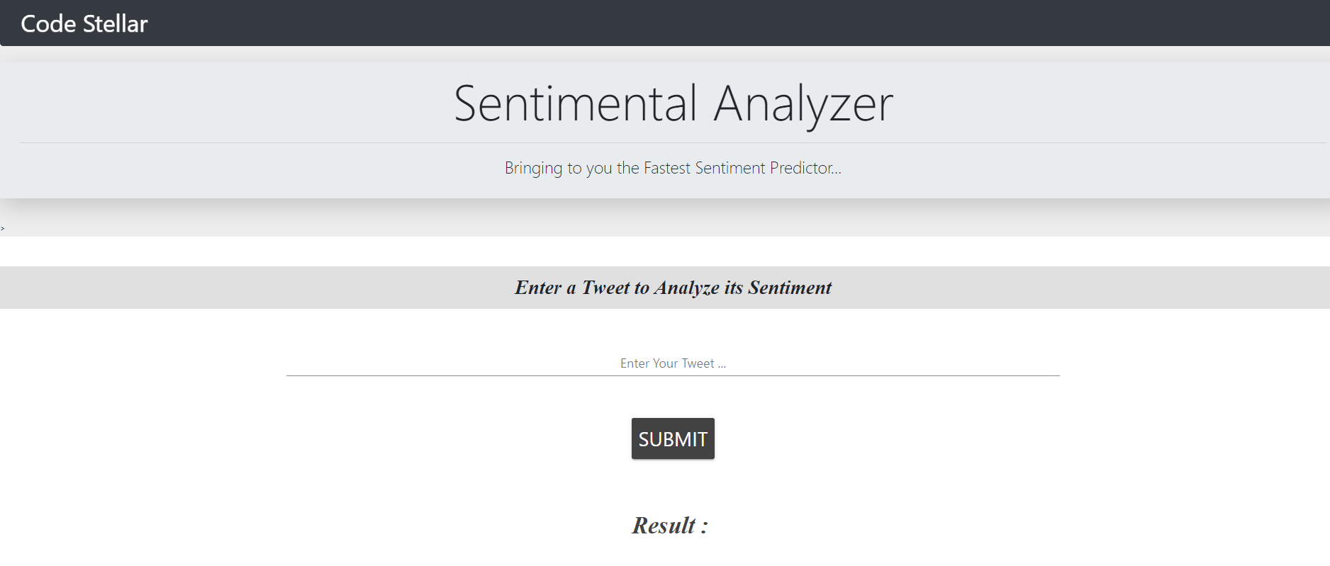
User Interface (User friendly)

Slide 7

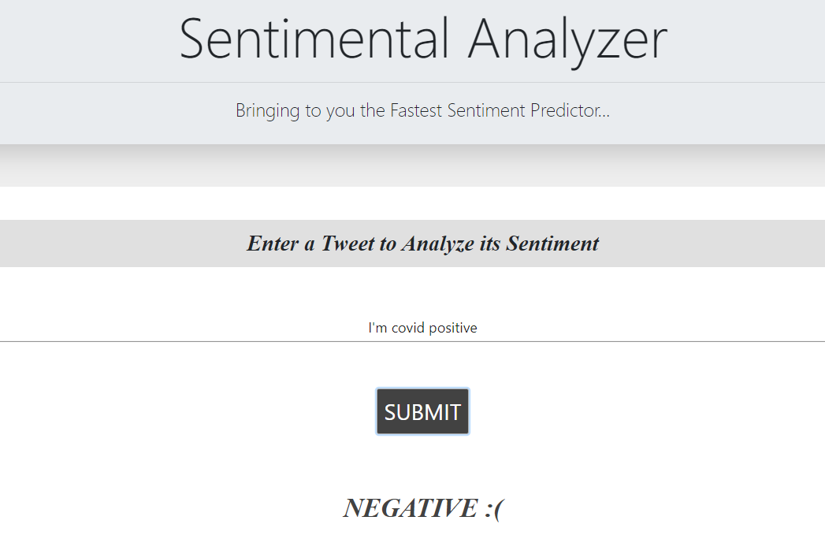
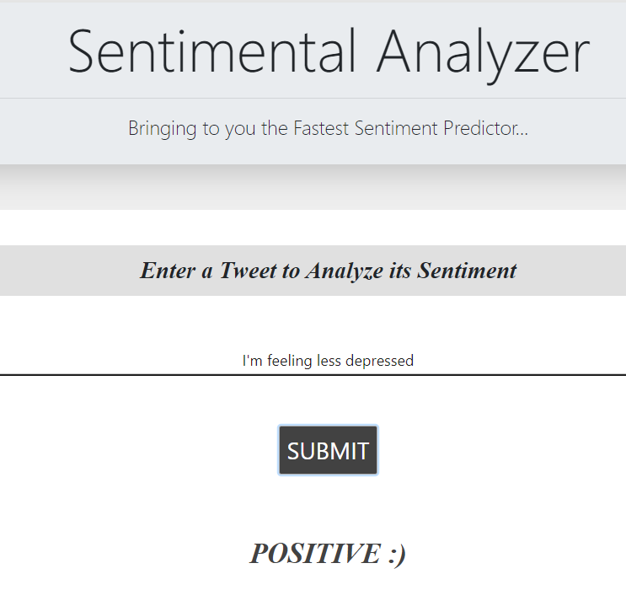
Stunning Accuracy!

Slide 8
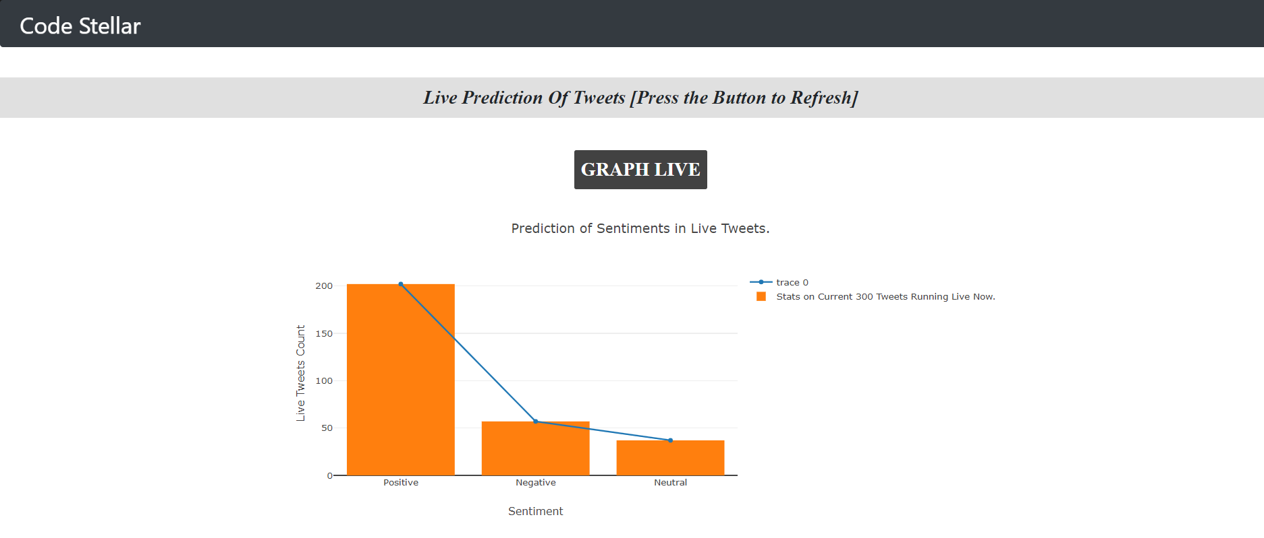
Stats on every 300 live tweets..

Slide 9
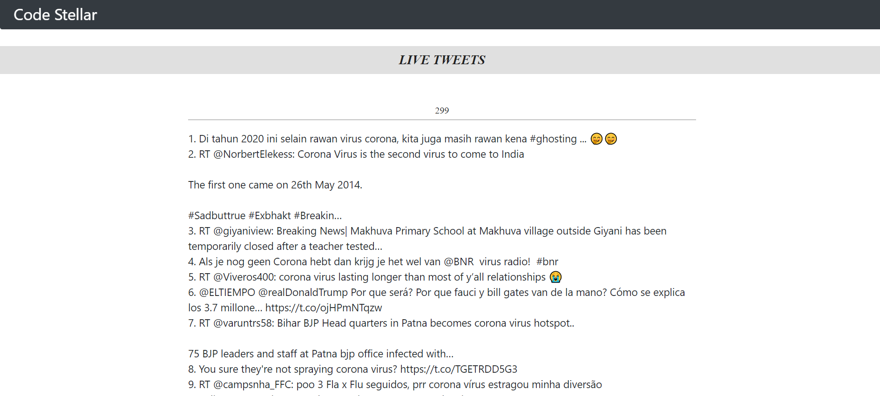
Up to 300 live tweets across the globe!

Slide 10
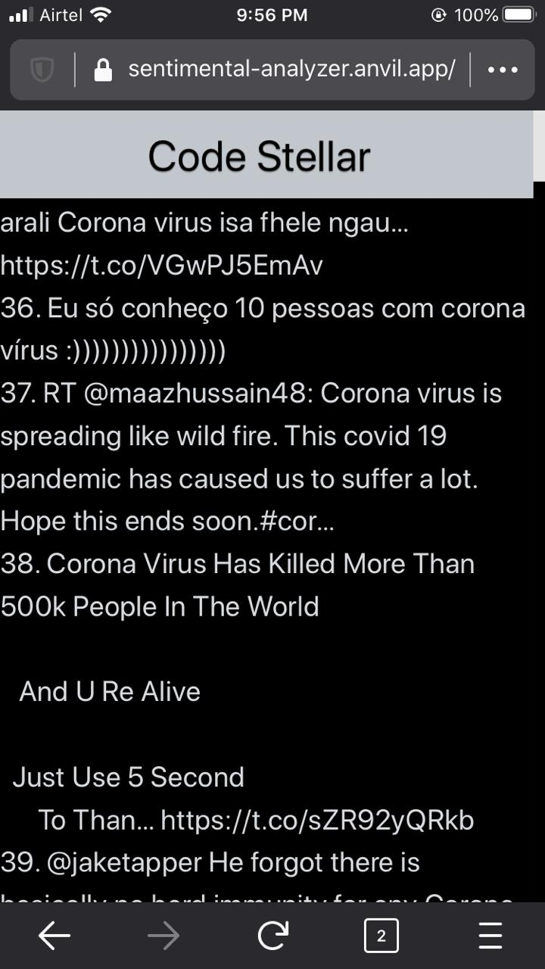

Live Tweet …

Slide 11
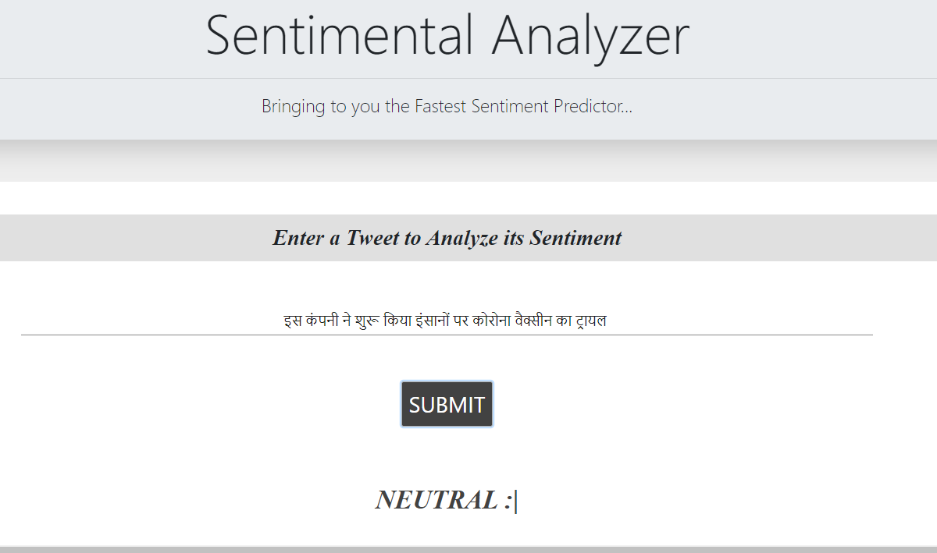
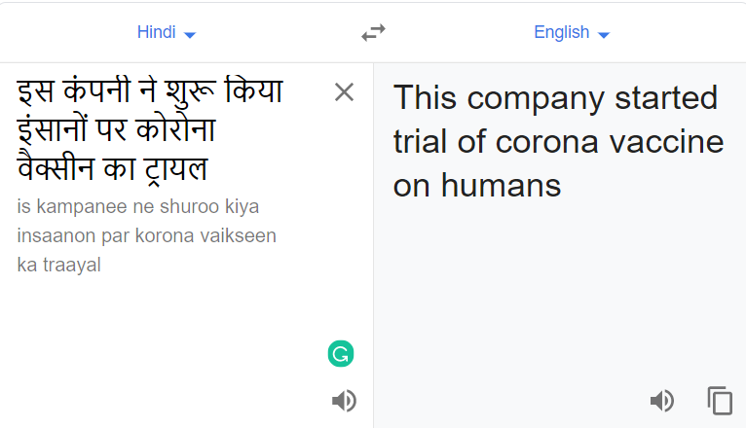
Multi-language sentiment Predictor

Slide 12
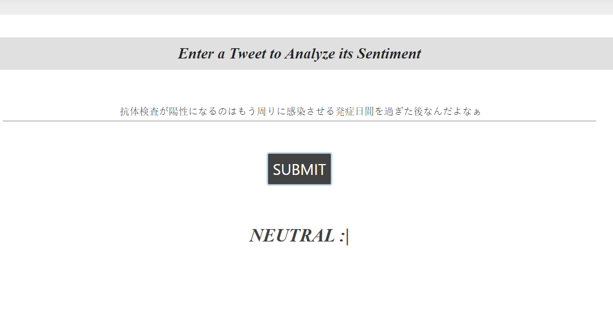
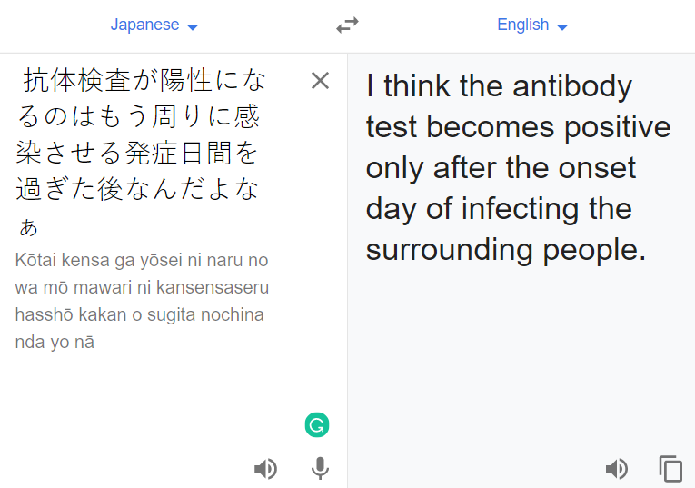

Slide 13


